Slide 1

IMU Noise During Data Collection
Soft Tissue Resistance Assessment Technologies
Judd Foster – 12 Oct 2022

Slide 2
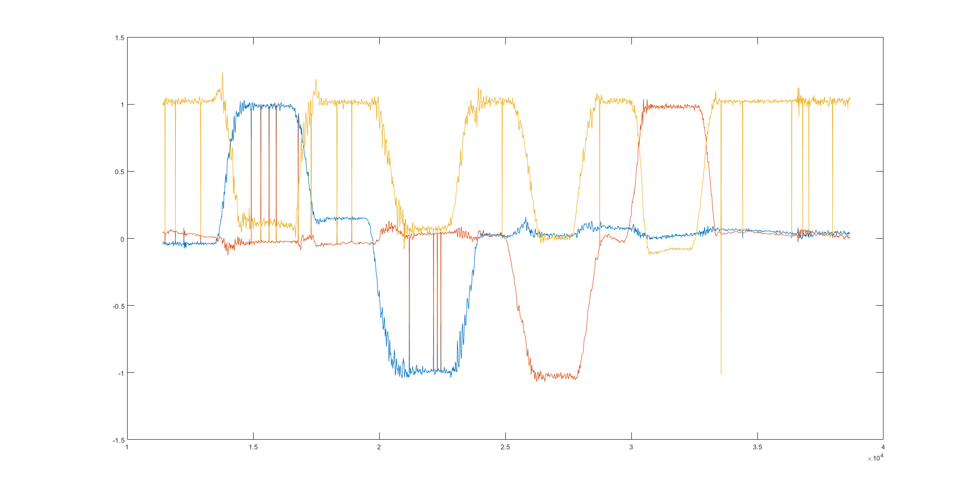
Shin Accelerometer (Without Filter)

Slide 3
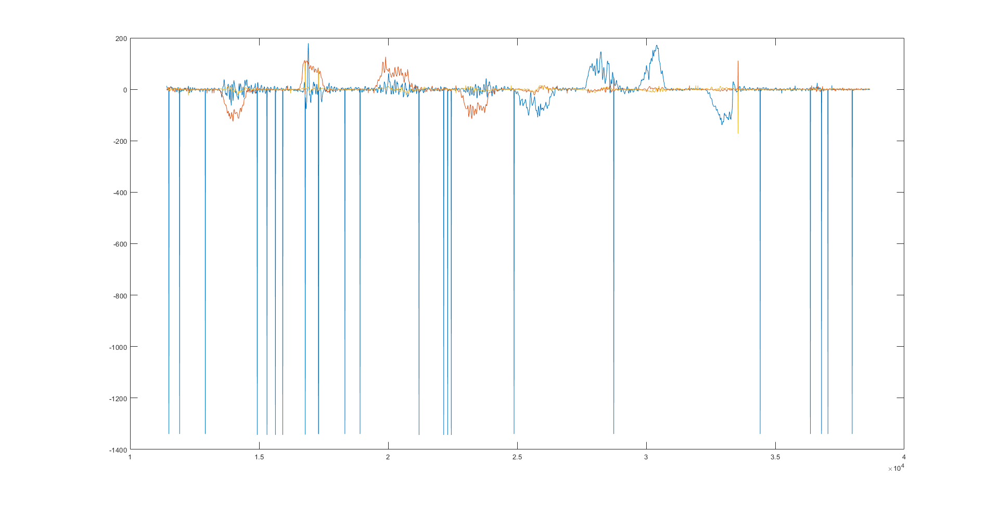
Shin Gyroscope (Without Filter)

Slide 4
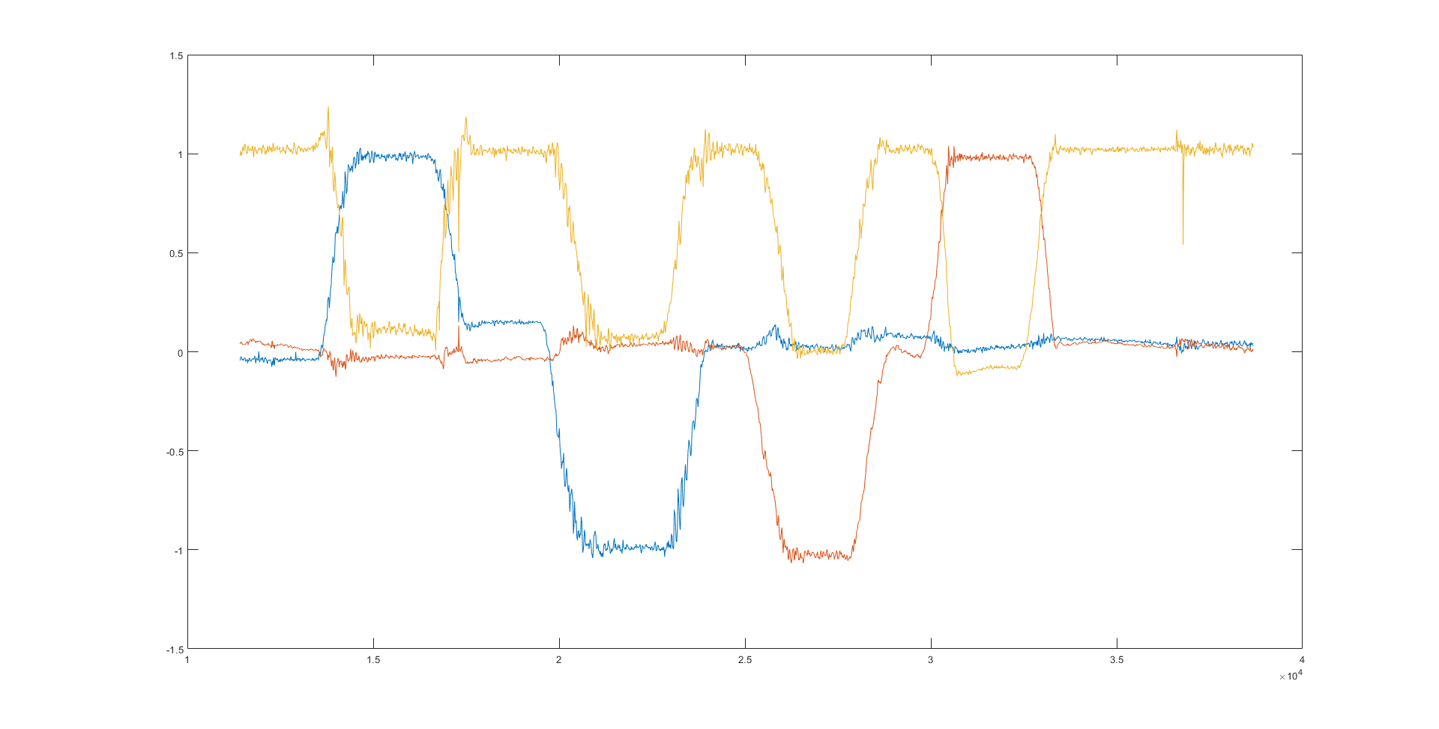
Shin Accelerometer (With Filter)

Slide 5
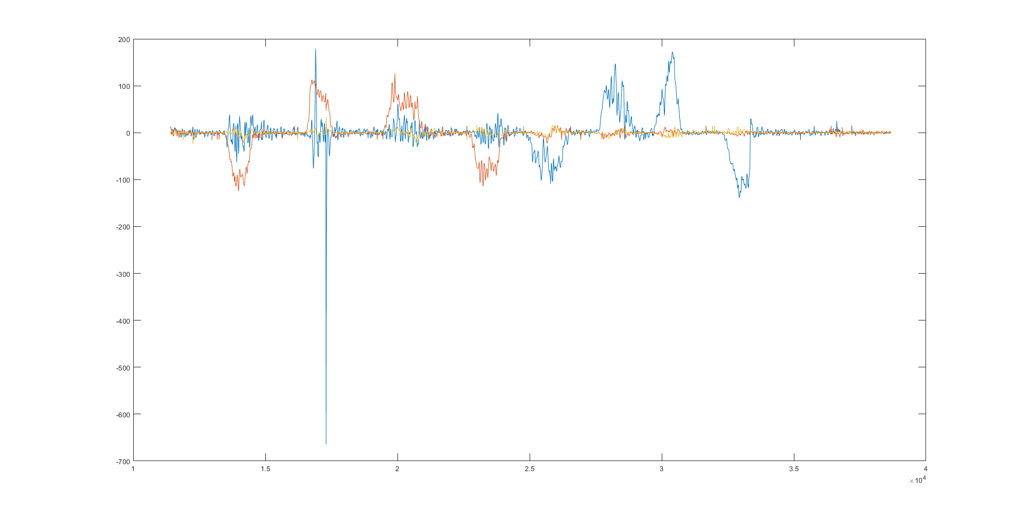
Shin Gyroscope (With Filter)

Slide 6
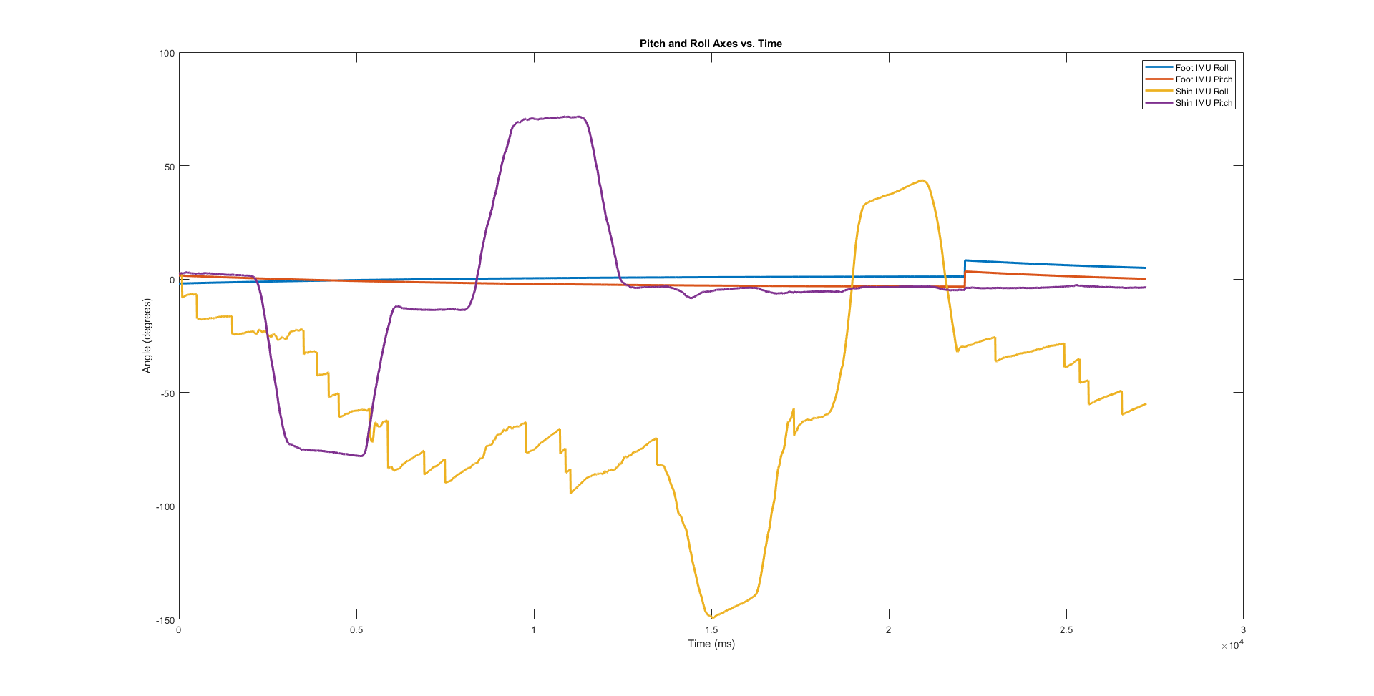
No Median Filter (Roll and Pitch Data)

Slide 7
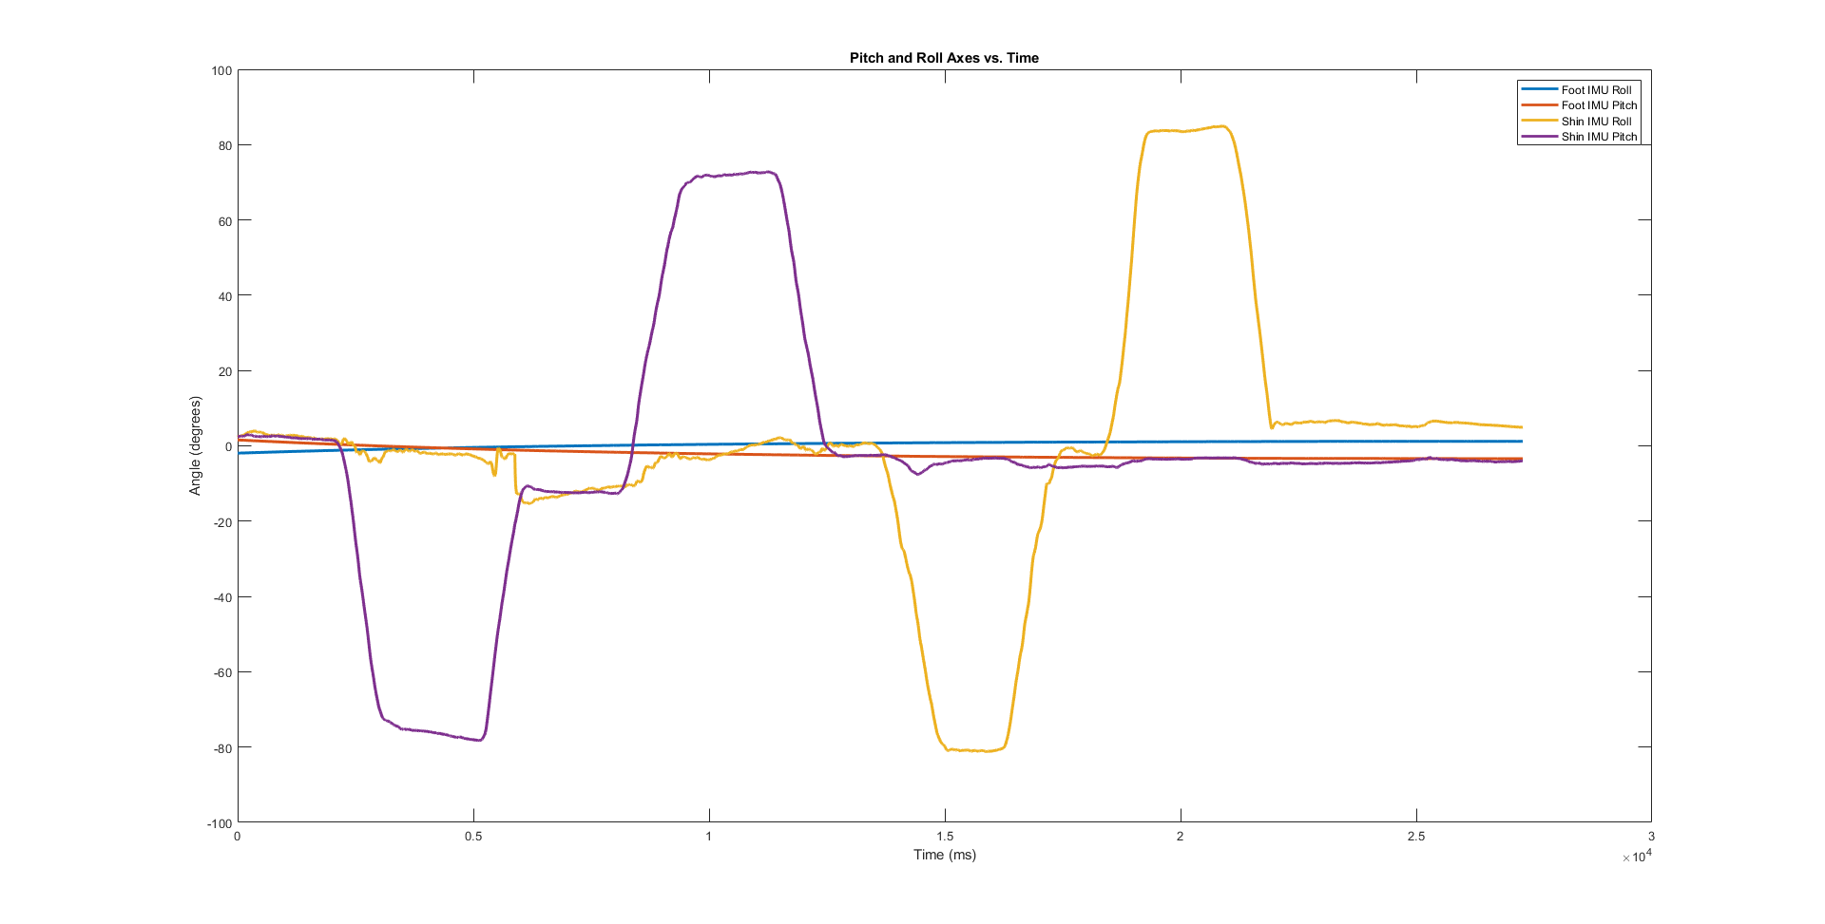
Median Filter (Roll and Pitch Data)

